Slide 1
Support Vector Machine - 실습
컴퓨터AI공학부
2023년 2학기 머신러닝

Slide 2
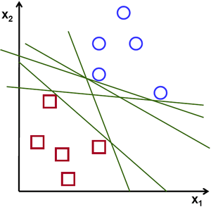

Review – Support Vector Machine
목적: Margin을 최대화하는 optimal separating hyperplane (decision boundary) 구하기
: Class 0
: Class 1
Ref.: https://towardsdatascience.com/

Slide 3
Review – Support Vector Machine
용어 정리
Support vector
Ref.: https://towardsdatascience.com/

Slide 4
Review – Support Vector Machine
용어 정리
Optimal separating hyper-plain
Support vector
Ref.: https://towardsdatascience.com/

Slide 5
Review – Support Vector Machine
용어 정리
Optimal separating hyper-plain
Weight (vector)
Normal vector
Support vector
Ref.: https://towardsdatascience.com/

Slide 6
Review – Support Vector Machine
용어 정리
Weight (vector)
Normal vector
Margin 방향의 unit vector
Ref.: https://towardsdatascience.com/

Slide 7
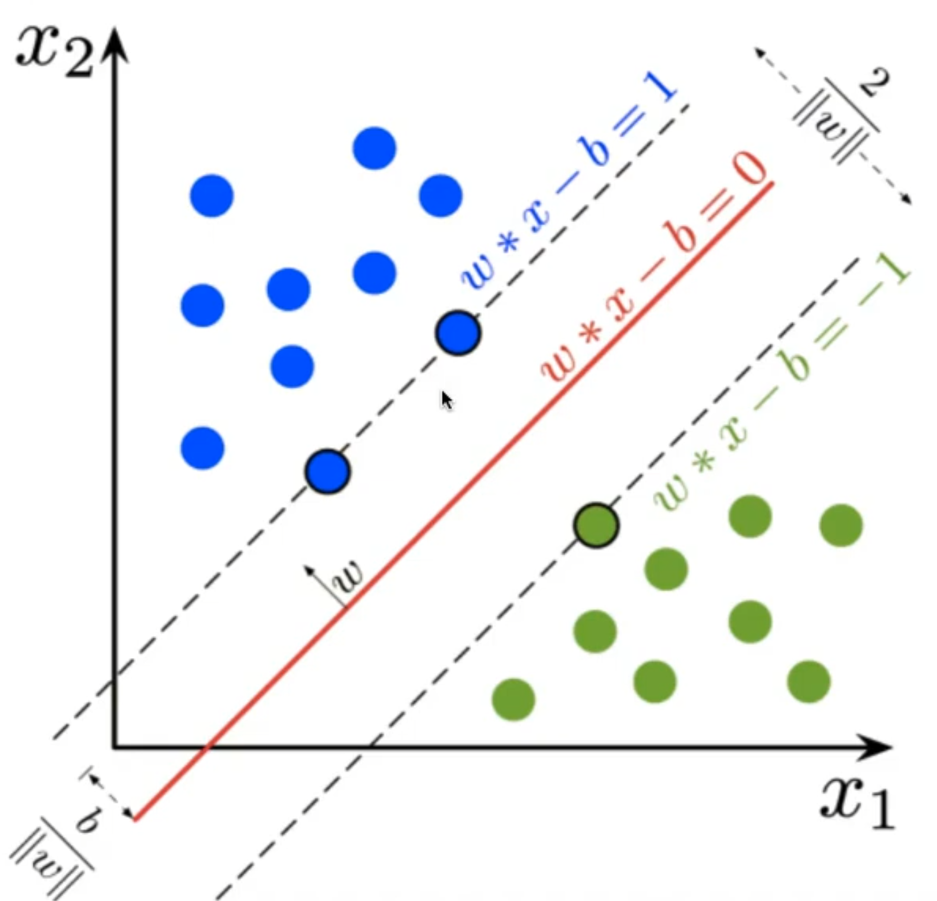
Review – Support Vector Machine
임의의 데이터 x_{i} 에 대해 separating hyperplane과의 거리: $ρ$
x2
Margin 방향의 unit vector
X_{i}
?
?
X_{p}
x1
Separating hyperplane

Slide 8
Review – Support Vector Machine
임의의 데이터 x_{i} 에 대해 separating hyperplane과의 거리: $ρ$
x2
1
X_{i}
2
X_{p}
3
4
x1
0
Separating hyperplane

Slide 9
Review – Support Vector Machine
Binary classification
3
1
: Optimal separating hyperplane
1
2
2
: Support vector (negative)
3
: Support vector (positive)

Slide 10
Review – Support Vector Machine
Binary classification
3
1
: Optimal separating hyperplane
1
2
2
: Support vector (negative)
3
: Support vector (positive)

Slide 11
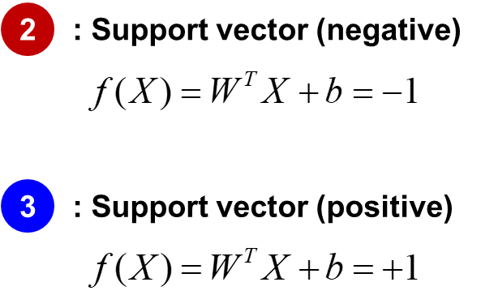
Review – Support Vector Machine
Margin 계산
3
2
-1

Slide 12
Review – Support Vector Machine
Margin 계산
3
2

Slide 13
[실습] Support Vector Machine
목적: Margin을 최대화하는 optimal separating hyperplane (decision boundary) 구하기

Slide 14
[실습] Support Vector Machine
목적: Margin을 최대화하는 optimal separating hyperplane (decision boundary) 구하기
Solution
Quadratic Programming (2차 계획법)
Gradient Decent Method (GD) → Optimal W, b

Slide 15
[실습] Support Vector Machine
Solution
Quadratic Programming (2차 계획법)
Gradient Decent Method (GD) → Optimal W, b
Gradient decent algorithm
현재 지점에서 미분을 이용해 gradient 계산
Gradient에 learning rate를 곱하고 반대 방향으로 weight update
Loss(θ)
Learning rate = 0.1
Gradient = 0.8
θ
optimal θ

Slide 16
[실습] Support Vector Machine
Loss function (Cost function): Hinge loss
Prediction
Label
→
→
Label
Prediction
이 조건을 만족하는 경우 정상적으로 분류 성공

Slide 17
[실습] Support Vector Machine
Loss function (Cost function): Hinge loss
Prediction
Label
→
Hinge loss
→
Label
Prediction
이 조건을 만족하는 경우 정상적으로 분류 성공

Slide 18
[실습] Support Vector Machine
Loss function (Cost function): Hinge loss
Prediction
Label
Hinge loss
→
→
→ Loss = +2
→ Loss = +1
→ Loss = +0.5
Label
Prediction
이 조건을 만족하는 경우 정상적으로 분류 성공
→ Loss = 0

Slide 19
[실습] Support Vector Machine
Loss function (Cost function): Hinge loss → Gradient
Hinge loss
1
2

Slide 20
[실습] Support Vector Machine
Loss function (Cost function): Hinge loss → Gradient
Hinge loss
1
1
Update 수행 X
2
2

Slide 21
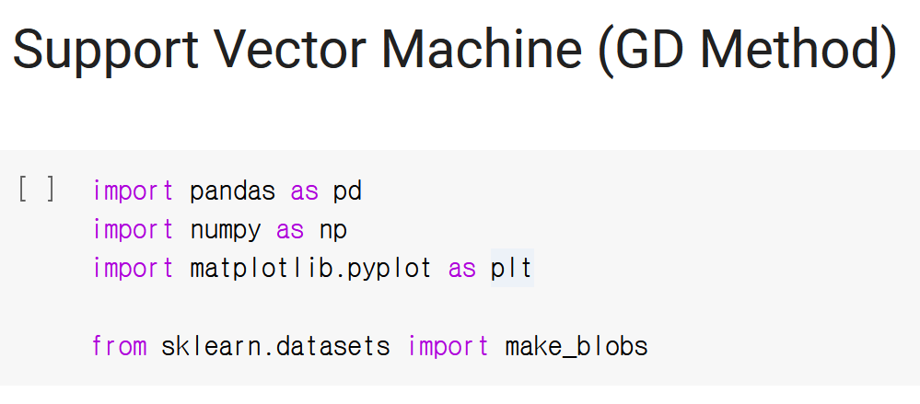
[실습] Support Vector Machine
Basecode 다운로드: LMS 강의 콘텐츠 13주차

Slide 22


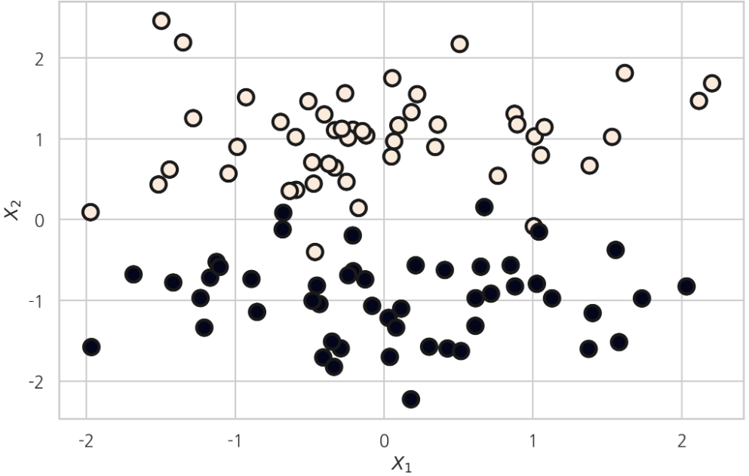
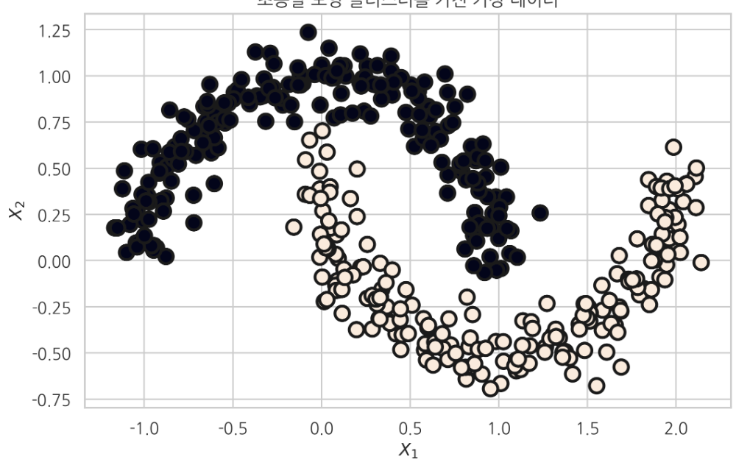


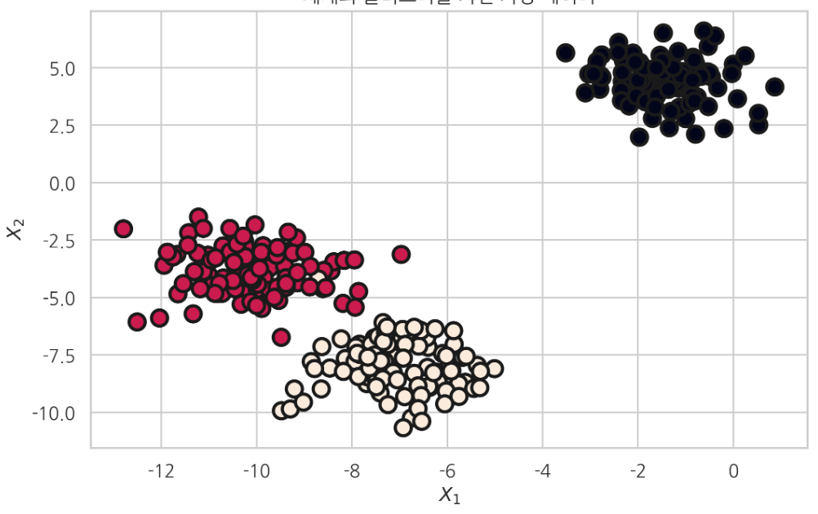
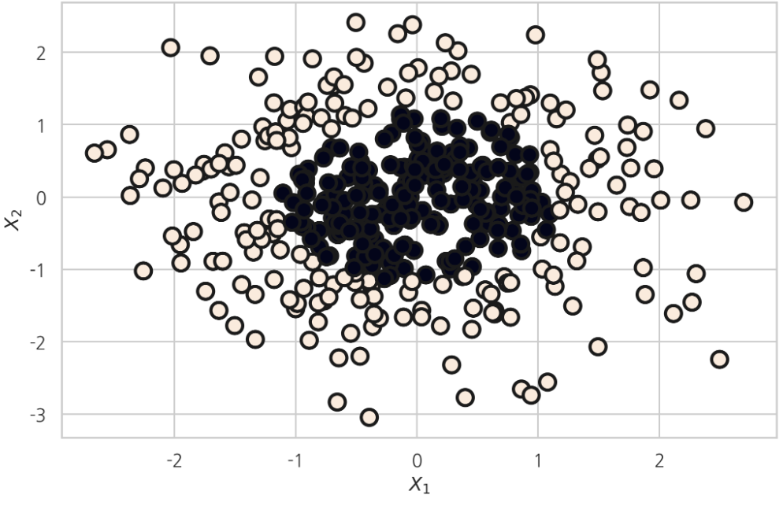
[실습] Support Vector Machine
데이터셋 생성: sklearn.datasets
Ref.: https://datascienceschool.net/

Slide 23
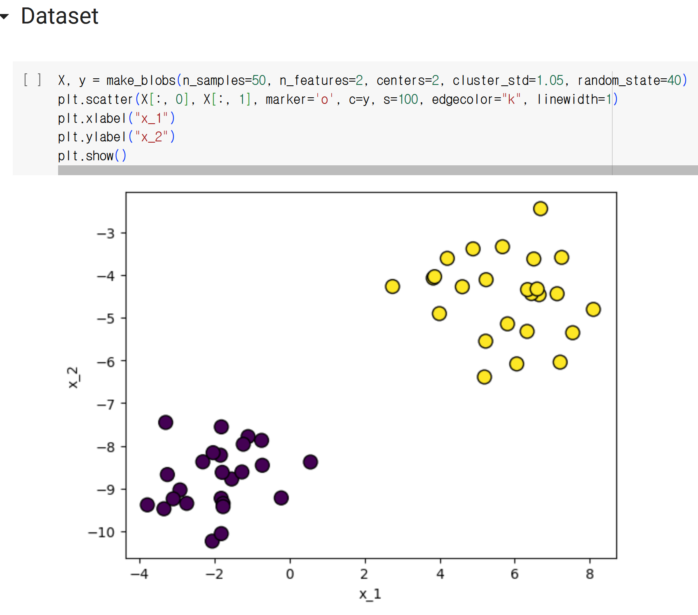
[실습] Support Vector Machine
데이터셋 생성: sklearn.datasets

Slide 24
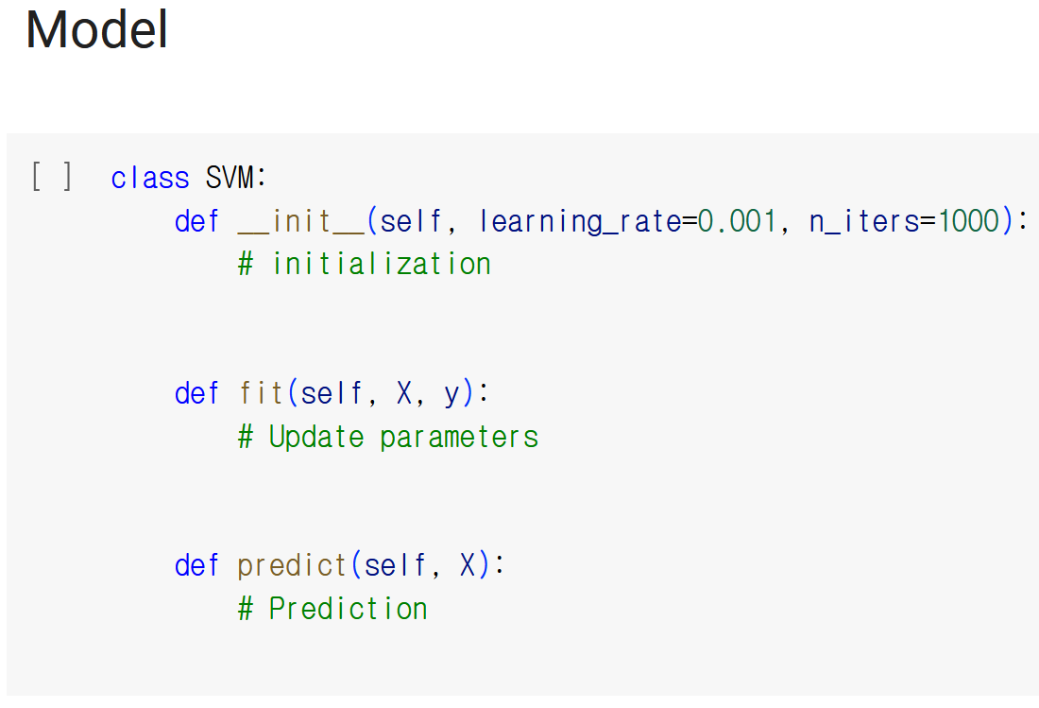
[실습] Support Vector Machine
SVM 모델 작성 및 gradient decent 코드 작성

Slide 25
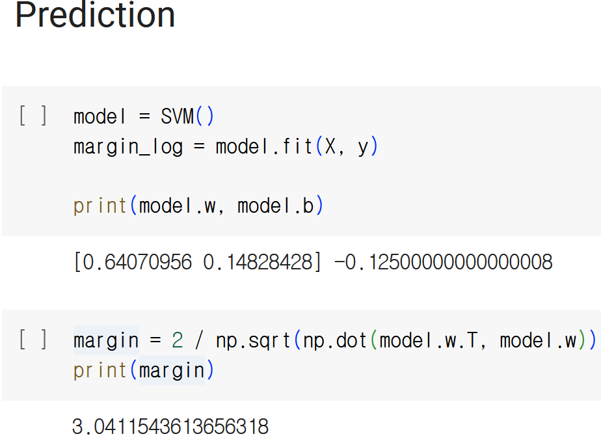
[실습] Support Vector Machine
SVM 모델 training 및 도출된 W, b값 확인

Slide 26
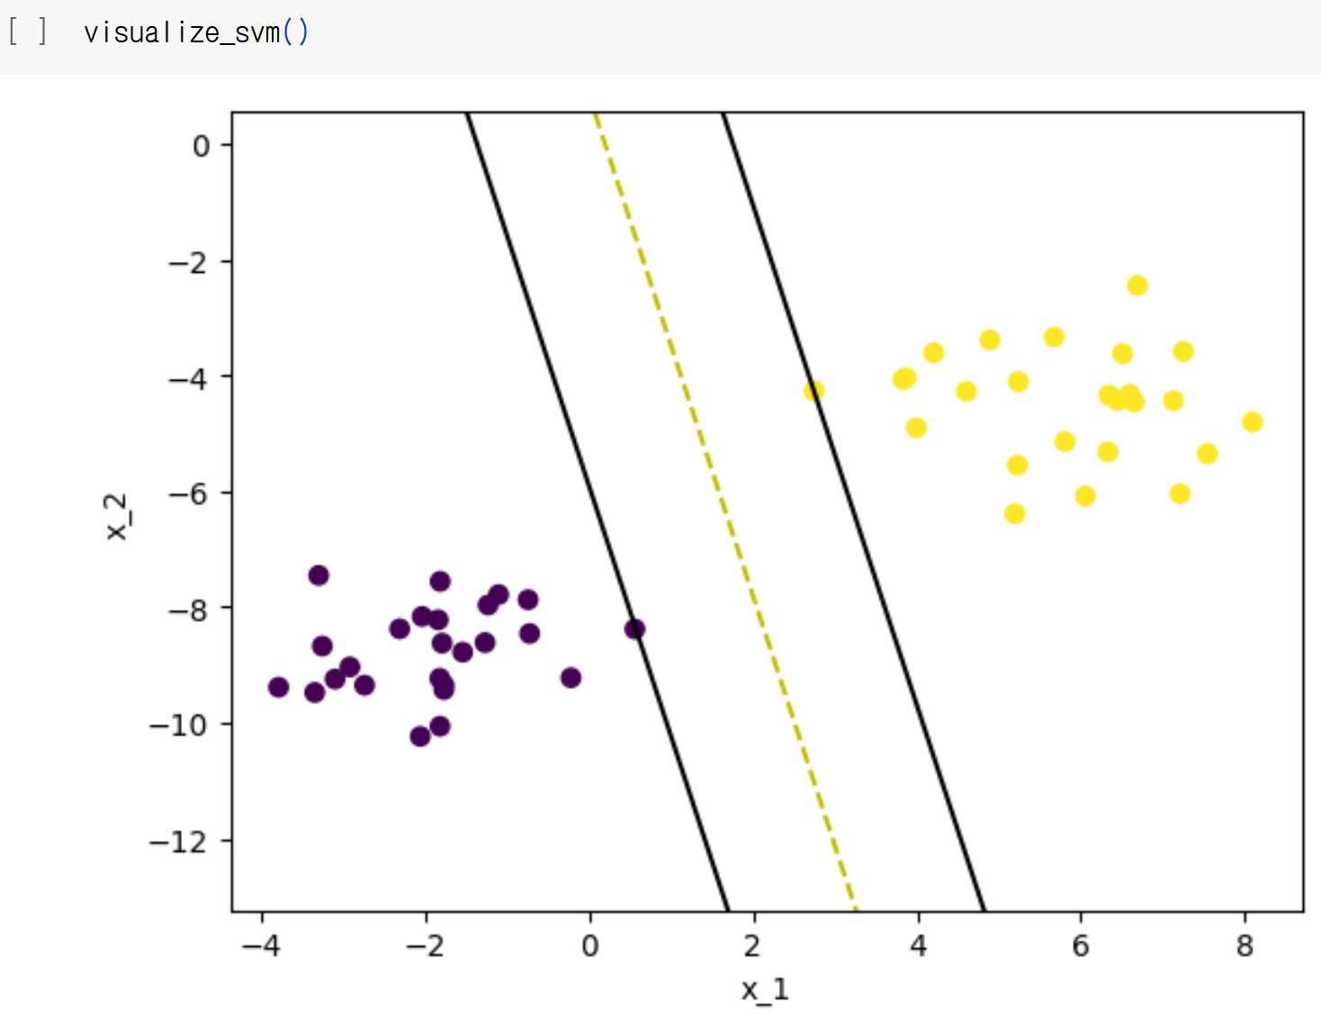
[실습] Support Vector Machine
Visualization
Margin

Slide 27
Dongsan Jun (dsjun@dau.ac.kr)
Image Signal Processing Laboratory (www.donga-ispl.kr)
Dept. of Computer Engineering
Dong-A University, Busan, Rep. of Korea

